Slide 1
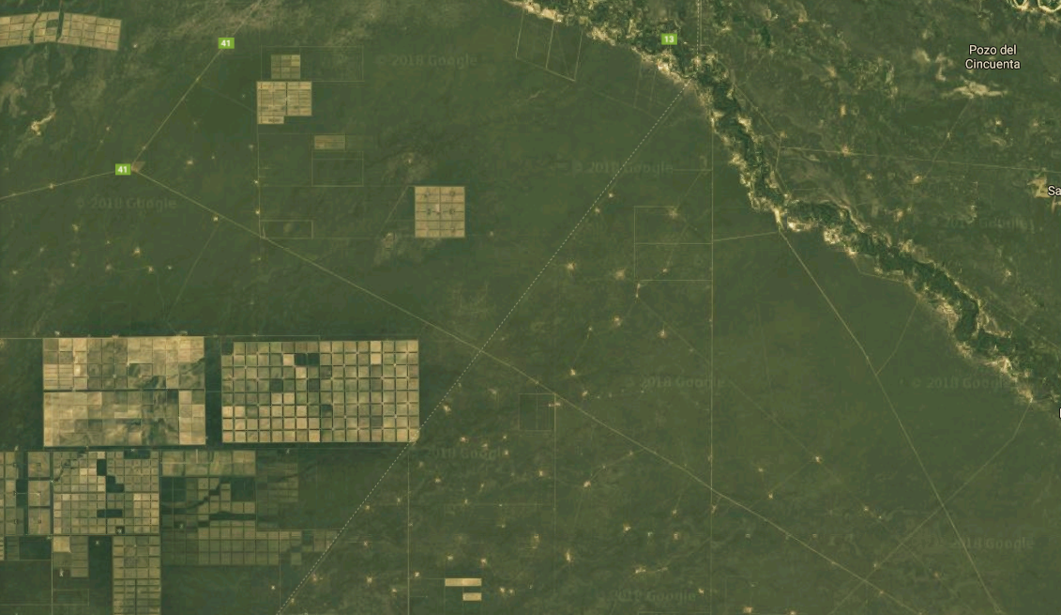

Systematic Conservation Prioritization using PrioritizR
Humboldt Universität
Conservation Biogeography
Summer
2018
Elizabeth Law
workingconservation@gmail.com

Slide 2

Agenda
Practical 1:
15 min Introductions, system set up.
30 min A first example of systematic conservation planning
40 min The NADC study area – data, gap analysis, basic prioritization, adding lock-in, or lock-outs, and connectivity
5 min Allocation of scenarios for practical 2
Homework: Think about your scenarios! Prepare some code to try, and research some of the discussion points.
Practical 2:
5 min Recap, system set up.
50 min Scenarios
30 min Class presentations (5 min / group)

Slide 3
Software & Data
We will be using R, and several contributed packages, including prioritizr.
This is because R has options for many of the latest analyses, and allows streamlined analyses across GIS and optimization.
This is a course about systematic conservation prioritization – not how to use R… we’ve tried to give you really clear instructions, but please ask if you are having trouble!

Slide 4

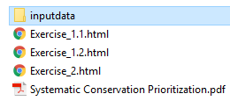
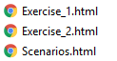
Software & Data
your folder
NOTE: everything in this PPT is in the Systematic Conservation Prioritization.pdf

Slide 5
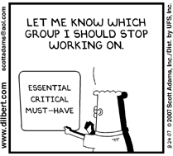
What is Systematic Conservation Prioritization?
What conservation actions?
Where? When?
WHY?
Limited resources, time, and (too) many species to save.
Complex problems

Slide 6
What is Systematic Conservation Prioritization?
WHY?
Limited resources, time, and (too) many species to save.
Complex problems
HOW?
Trade-offs mean that decisions can be ‘contested’
Evidence based, repeatable, transparent
WHAT?
Be effective, by being representative of ‘biodiversity’
Minimize trade-offs/conflict by being efficient (complementarity)

Slide 7
Example
Study area
3
Planning units
2
2
Budget = 3 units
Species Richness
3
5
1
Complementarity

Slide 8
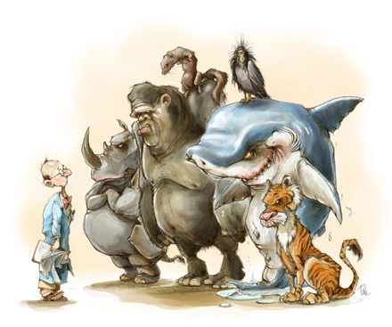
Triage
Should we give up on species that are ‘too costly’ to save??
This is a really current, critical ethical problem
Rigorous argument needs information:
we need to understand prioritization
Wilson, K.A., Law, E.A. (2016) Ethics of conservation triage. Frontiers in Ecology and Evolution 4:112
Cartoon found without attribution on https://conservationbytes.com

Slide 9
Elements of a prioritization
An objective(s): what do you want to minimize or maximize?
A list of available options: e.g. conservation actions in space and time.
Information on benefits: what each of the actions will achieve for each feature.
Information on costs: how much each action will cost.
(optional) Information on other constraints: e.g. threshold targets to achieve, budgets not to go over, areas that need to be ‘locked in’ to certain actions, or ‘locked out’ from other options.

Slide 10
A small example:
Objective: Minimize cost of reserve network
A list of available options: Planning units (pu) in reserves
Benefits: what each of the pu will achieve for each feature (species).
Costs: how much each pu will cost
Constraints: threshold targets to achieve = 17% of the total possible of each species.

Slide 11
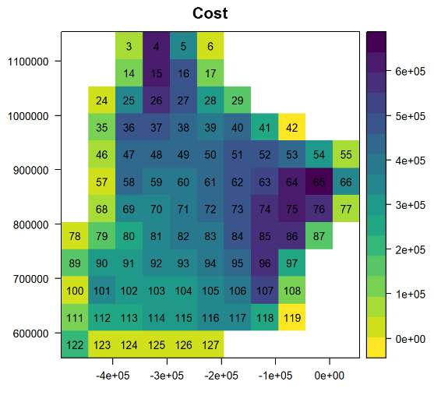
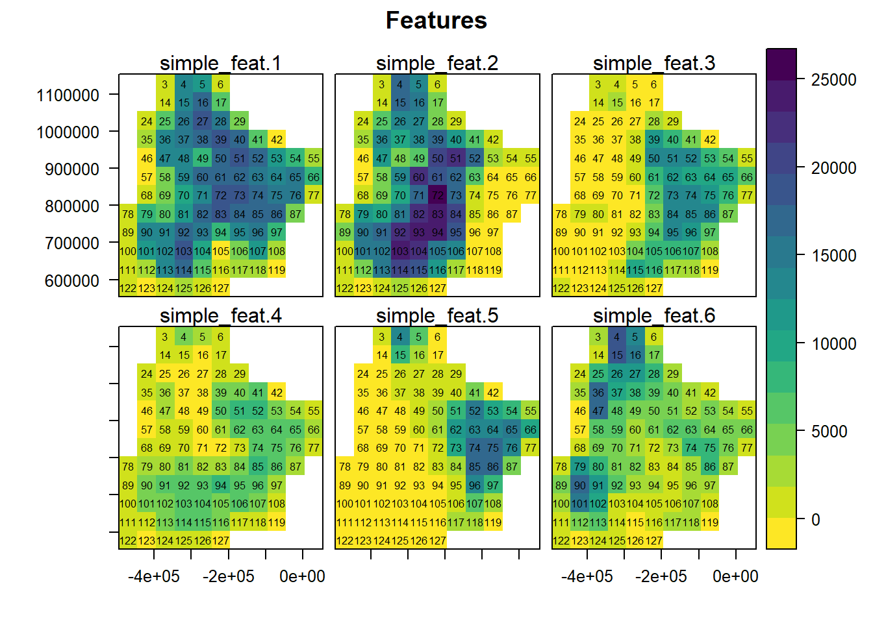
Simple example
Problem: Select a reserve network
Objective: Minimize cost
Targets: 17% of each species

Slide 12
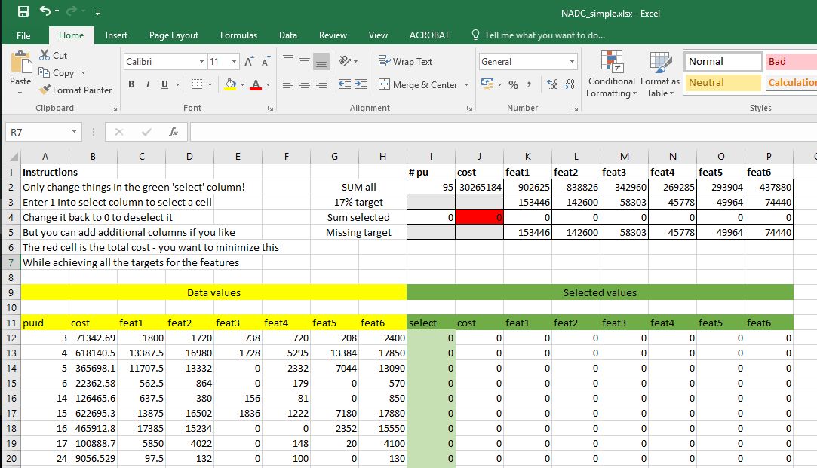
File: NADC_simple.xlsx
Problem: Select a reserve network
Objective: Minimize cost
Targets: 17% of each species
These are your targets
‘Achieved’ will increase as you select cells
Aim to get ‘missing’ to below zero
While minimizing cost
This is what each planning unit costs
And the benefits it gives
And values will show up here when selected

Slide 13
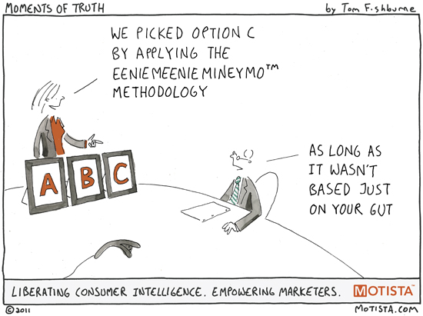
What strategies did you use?
Did you…
Minimize Cost / Benefit?
Maximize Benefit / cost?
Consider…
Benefit = sum (all species) ?
Complementarity when some targets already reached?
Yes – there is software to do this easier!

Slide 14

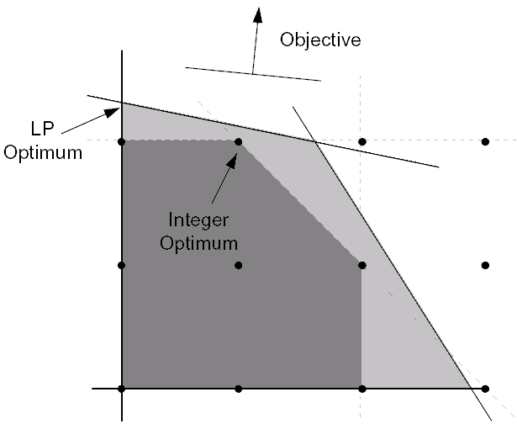
Problems and algorithms
Problem: The mathematical specification of the issue
e.g. the Minimum Set (knapsack) problem
Algorithm: the methods used to solve it
Heuristic methods
(random start and search solutions)
e.g. genetic algorithms, simulated annealing
Exact methods (identify solutions using math) e.g. Integer / Linear Programming

Slide 15

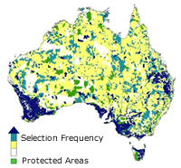
Existing software
http://marxan.org/
Problem: minimum set
Algorithm: simulated annealing

Slide 16

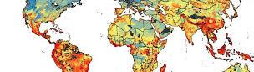
Existing software
https://www.helsinki.fi/en/researchgroups/metapopulation-research-centre/software#section-14300
Problem: …iterative removal of ‘least valuable’ cell
Algorithm: set of greedy heuristics

Slide 17


Existing software
prioritizr
https://prioritizr.net/
Problem: minimum set
Algorithm: Integer linear programming

Slide 18

Let’s see how well prioritizr can do on our problem
https://www.rstudio.com/
Open RStudio
Follow the instructions in Exercise_1.html

Slide 19
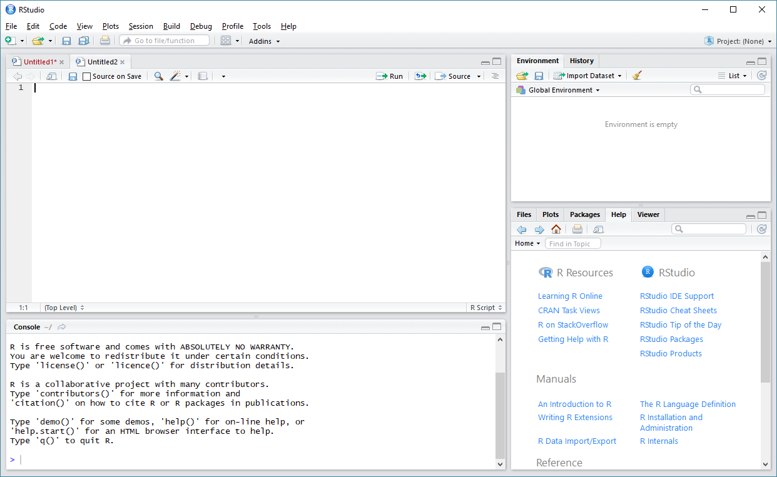
New script
save.r
(~txt file)
Run
https://www.rstudio.com/
Objects, history, etc.
Script editor
Help
Plots
Etc.
Console

Slide 20
Example _1.html
Installs and loads packages (libraries of functions)
Specify where your data is (!! Data needs to be unzipped, and folder location corrected)
Load data into R
Check data loaded correctly
Specify the basic prioritizr problem
Solve & examine results

Slide 21
Are you ready for the solution?

Slide 22
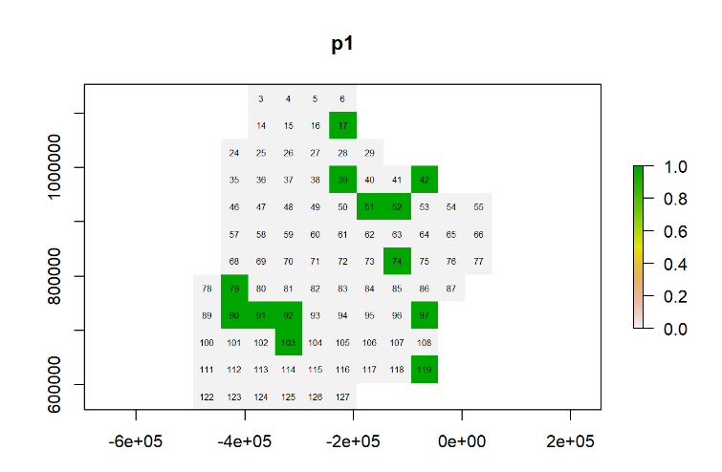
What did prioritizr pick?
COST =
3 727 235

Slide 23
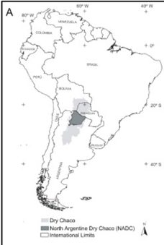
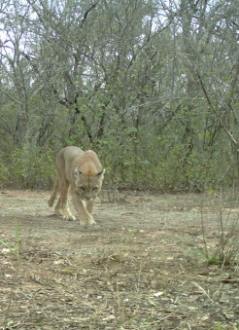
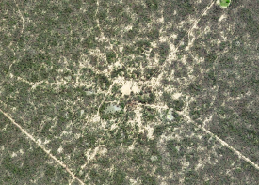
The North Argentinian Dry Chaco (NADC)
172 800km²
Semi-deciduous dry forest
46 tree spp.
>400 bird spp.
145 mammals
30 amphibians
Indigenous areas,
Livestock grazing,
Increasing agribusiness (soy, intensive pasture)
Satellite from GoogleMaps; Camera trap photos from INTA / Asun; Figure from Gasparri et al 2015 https://doi.org/10.1016/j.jaridenv.2015.05.005

Slide 24
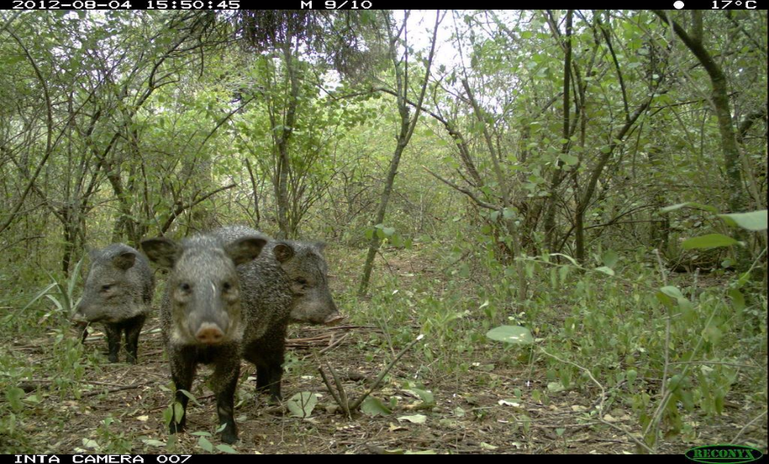
Driving questions
How can we balance production with biodiversity?
Where are the most important areas to protect?

Slide 25
NADC PrioritizR exercises
Exercise_2.html
Open R via RStudio
Install and load the required packages
Load and explore the 10km resolution data
Conduct a simple ‘gap analysis’
Construct a prioritizr problem, with lock in and lock out options
Solve this, and explore the solutions
Add connectivity constraints to the problem
Solve, and explore the solutions
Remember: this is not a course on R! We can help with the code, but we want you to understand the concepts.

Slide 26
NADC PrioritizR exercises
Discussion points
What areas are we considering ‘available’ and contributing to conservation?
What does it mean to have ‘threshold’ target constraints? What might be alternatives?
How might we incorporate ecosystem types or other features?
How might we avoid ‘bad’ features?

Slide 27
NADC PrioritizR exercises
Scenarios.html
To explore these questions more deeply, we will split into groups to develop scenarios
Homework: Complete Exercise 2. Think about your scenario, the concepts of the analysis, maybe prepare some code, and research some of the discussion points. Some hints and tips are in Scenarios.html
How does cost scale with different targets?
Can different species group proxy for each other?
How does cost scale with connectivity?
Lock in and lock out options
A portfolio of solutions

Slide 28
NADC PrioritizR exercises
Discussion points
What do our results mean for prioritization in the NADC?
Why might we lock in protected areas to the baseline?
What are the justifications/consequences of different targets?
What does it mean for groups to proxy?
Locking in/out versus cost-based specifications
Communicating multiple solutions
Vector based inputs – (potential for better ‘connectivity’ specification via these)
Zone formulations – inc. zone based targets.

